Slide 1
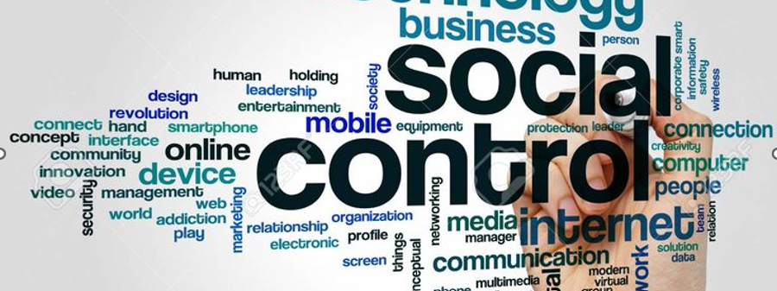
Socialization (Social control and Deviance)

Slide 2
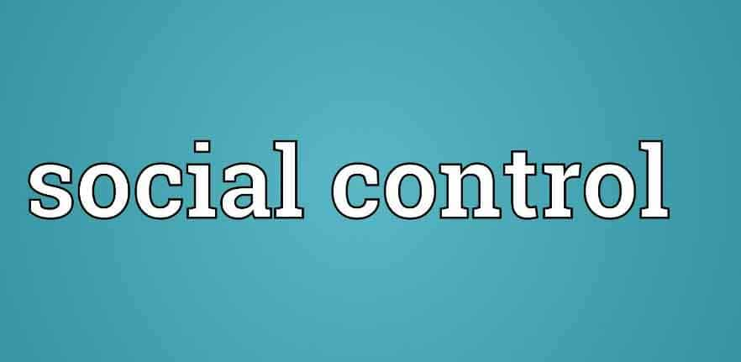
Presented By: Ahmad Shahzad Taha Khadija Minahil

Slide 3

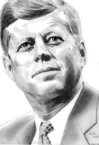


Roles of the individual
Status: social position a person occupies
Status set: all the statuses a person holds at a given time
Ascribed status: social position a person receives at birth or assumed involuntarily later in life (daughter/son, widow, American)
Achieved status: a social position a person assumes voluntarily that reflects personal ability & effort (honor student, Olympic athlete, spouse, thief, teacher, parent)
Master status: status society defines as having special importance (Kennedy, celebrity, women, AIDS patient)

Slide 4

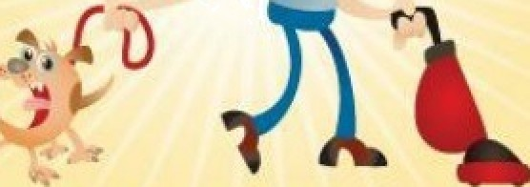
Roles:
Role: behavior expected of someone of a particular status
Role set: number of roles attached to a status (wife, mother, teacher, adviser)
Role conflict: conflict among roles corresponding to two or more statuses (wife & mother)
Role strain: tension among the roles attached to a single status (boss/co-worker)
Role exit: the process by which people disengage from social roles (ex-husbands, ex-nuns, ex- soldiers

Slide 5
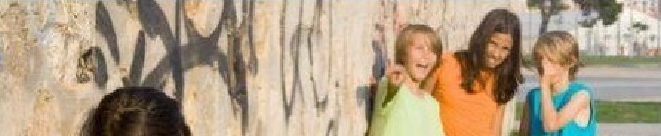
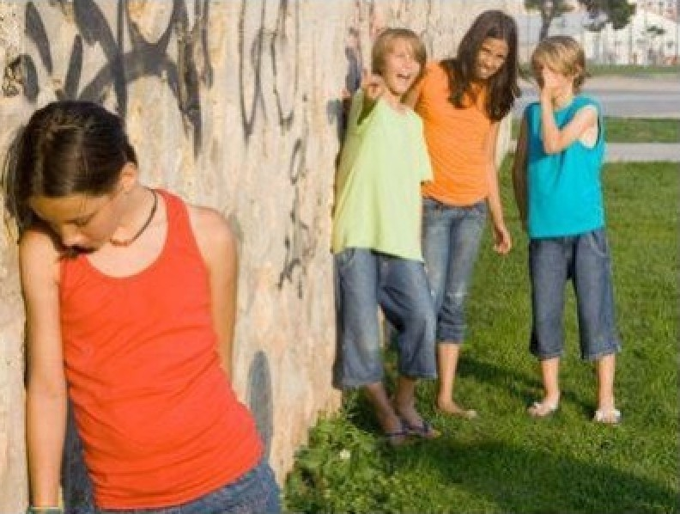


Individual Development Theories
“looking glass self”:
self-image based on how you think others see
you
primary group: small social group whose members share personal & enduring relationships (family, friends)
Secondary group: large impersonal social group whose members pursue a specific goal/activity (work, team)

Slide 6
George Herbert Mead: Social Behaviorism
Self: part of the personality composed of self- awareness & self-image
Develops with social experience (the exchange of
symbols); doesn't exist at birth
° Understanding intention requires imagining the situation from the other person's point of view
° By taking the role of the other we become self- aware (the “I” & the “me”)
Generalized other: widespread cultural norms& values we use as a reference in evaluating ourselves

Slide 7
The self is able simultaneously to take the role of:
No one {no ability to take on the role of the other)
One other in one situation
Many others in one situation
Many others in many situations
When...
Engaging in imitation
Engaging in play
Engaging in games
Recognizing the
generalized other

Slide 8
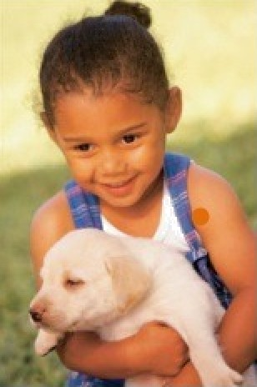

Stages of Socialization
Childhood: varies based on culture,1-12 yrs. of age (covers infantry as well)
Adolescence: teenage years (depends on social status)
Adulthood: 20s to early-60s (early, middle, late) school, marriage, children, work
Old age: Mid-sixties & up, retirement. Structure varies according to culture & time

Slide 9
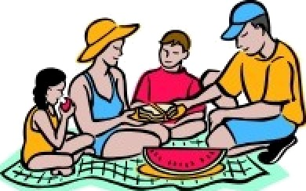

”“
Factors of
Socialization
Family: Greatest impact (children learn norms ,behaviour). Adaptability and lifestyle.
School: Impacts views on race/gender, superiority of our culture, experience bureaucracy, gender roles.
Peer group: Friends, relationships. Similar Age, influence.
Mass media: TV (political bias), newspapers, radio, Internet, movies

Slide 10
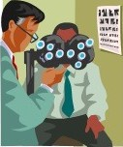

Gender socialization
Gender roles: dictate color associations, like pink for femininity and blue for masculinity.
Interaction with Babies: reinforces gentleness for girls and toughness for boys.
Boys are encouraged to prioritize winning and clear goals, while girls are socialized to emphasize communication and cooperation.
Men tend to major in technical fields, while women lean towards medical, humanities and social sciences in education.

Slide 11

Racial Socialization
Racial socialization: Involves children acquiring their ethnic group's behaviors, perceptions, and values, shaping their group identity.
Cultural socialization: Teaches children about their racial history and heritage, fostering pride in their cultural background.

Slide 12

Deviant behavior & society
Deviance: Violating cultural norms, resulting in societal disapproval.
Social control:
Attempts by society to regulate people's thoughts & behavior (formal [criminal] & informal [shame, ridicule] sanctions)
Medicalization of deviance:
The process of defining a behavior as an illness or medical disorder and then treating it with a medical intervention. Examples: drug addictions, ADHD, depression.

Slide 13
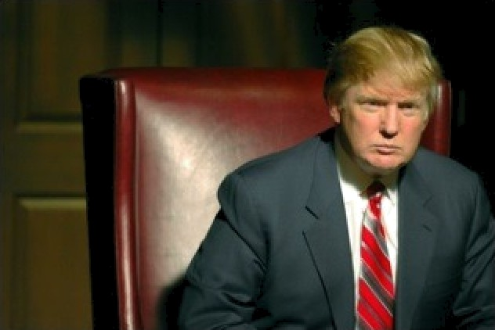
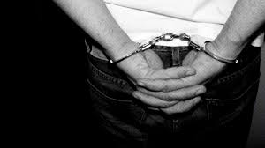
Deviance
& power
Norms reflect the interests of rich/powerful
Powerful have resources to resist deviant labels
Widespread belief that laws/norms are good masks their political character (are they inherently unfair?)

Slide 14
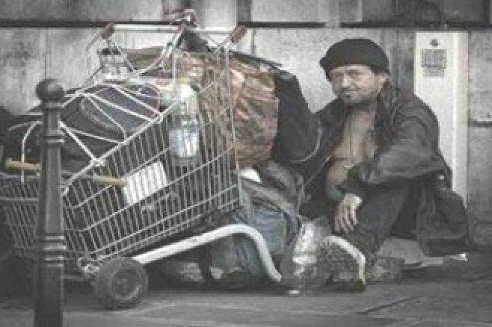
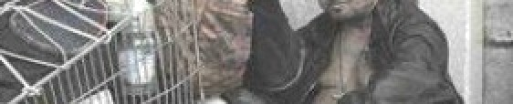
Causes/impact of deviant behavior
Merton, Cohen, Miller, Anderson: inability to succeed leads to deviance
Impact: Increased poverty, crime rates,
imprisonment, cycle of poverty

Slide 15
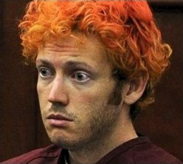
Labeling
Theory
Deviance and conformity result not so much from what people do as from how others respond to those actions
Stigma: powerfully negative label that changes a person's self-concept & social identity
Retrospective/projective labeling: re-
interpret past actions/predict future ones
Are they “sick,” or are they “bad?”

Slide 16
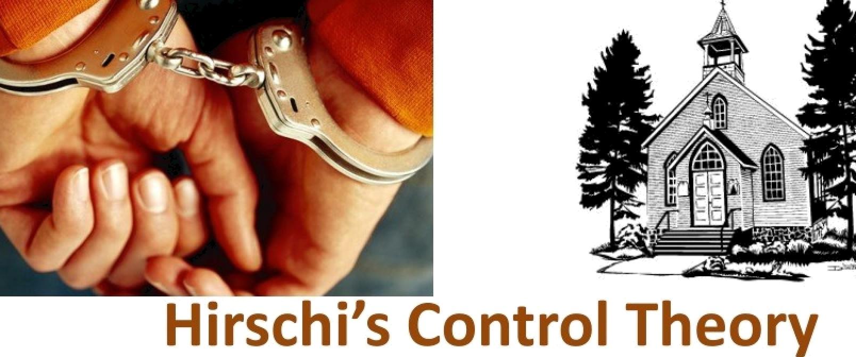
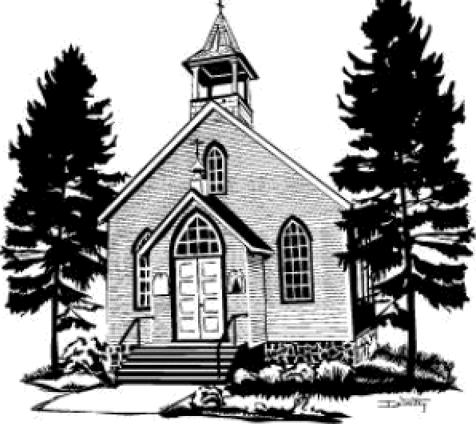
Social control depends on imagining the consequences of one's behavior...too much to lose? Nothing to lose?
4 types: social attachments, access to legitimate opportunity, involvement in legitimate activities, strong belief in morality/respect for authority

Slide 17
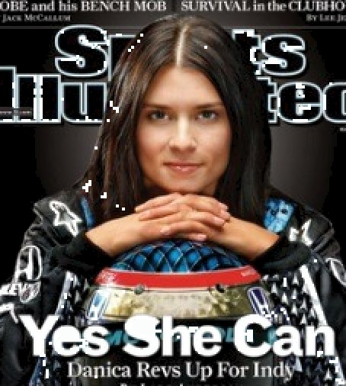
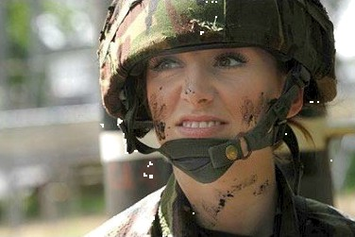
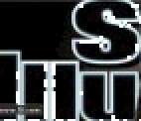


Gender & deviance
More rules for women than men worldwide...serious punishments for minor offenses in some places, because they're women
Limited opportunities in workplace, politics, military & athletics; relationships over $
Men who assault/kill women punished far less than women who kill men; women often blamed for assault/rape/harassment/abuse
Commit far fewer crimes than men why?

Slide 18
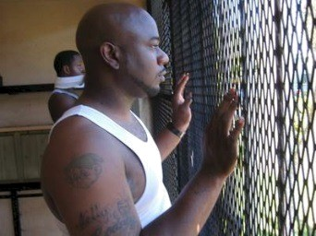
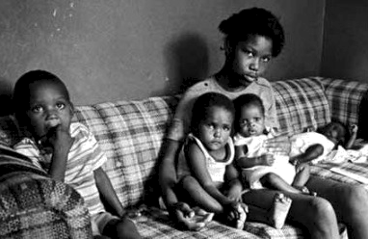

Race
deviance
Criminal justice system: society's formal system of social control
African-Americans commit disproportionate% of
crimes. Why?
Prejudice: more likely to be arrested,
stereotyping/profiling
° Race 0 social standing
Family structure: more single mothers, less
supervision, more likely to be poor
Statistics are skewed: don't include white collar crime
or DUI

Slide 19
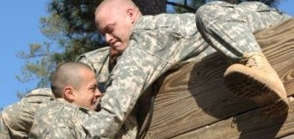
Conformity
Accommodation: working agreements between groups that permit cooperation; the outcome of conflict; how people respond to changing conditions so they can adapt
Adaptation: the natural result of competition; adapt or become extinct! Survival of the fittest
Cooperation: working together to achieve a goal
--ensures survival
° Competition: unlimited needs/wants, limited resources; level varies some societies discourage too much, others encourage it

Slide 20
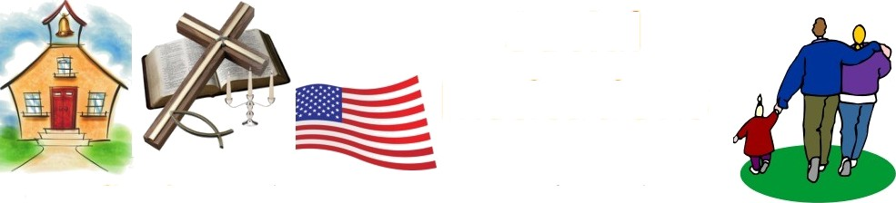
Social
institutions
Defined: complex, integrated set of social norms organized around the preservation of a basic societal value perform certain tasks, maintain order.
Family: reproduction, provides support system, teaches responsibility
Education: provides culture, prevents inequality,
teaches lessons about past, checks government
Religion: belief system, right & wrong, serving others
Economy: production of goods, ensure prosperity
Government/politics: order/stability, protection
Health care: physical care

Slide 21
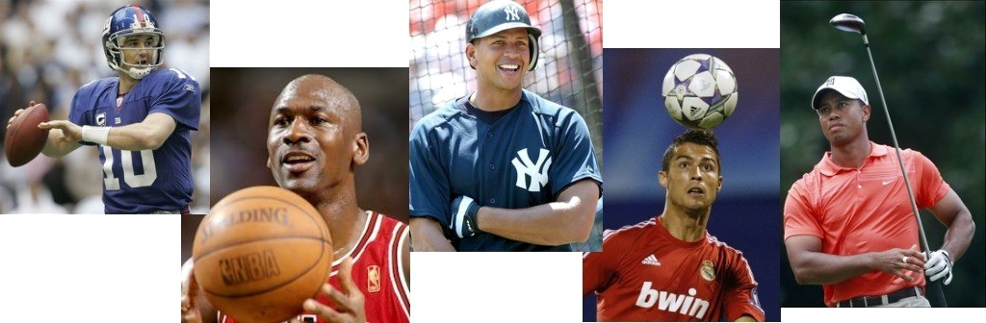
Sports as a social institution
Americans love sports & athletes!
Reflect social standing (some sports are too expensive for lower income people)
Complex form of face-to-face integration
Process of competition & cooperation

Slide 22
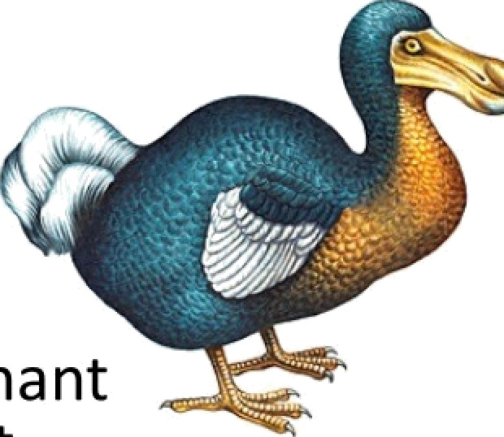
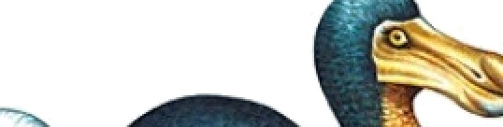
Science as a social institution
Rational. Reflects/reinforces the dominant values/views of society. Can be a direct translation of social experience we expect science to improve our lives.
Darwin's theory of evolution by natural selection: universal struggle for existence: took early-19th-century political economy & expanded it to include all of natural economy.
Scientists broke nature down into “pieces,” when it was seen as a mysterious whole before; now we look at the bits (atoms, cells). Science changed our view of the world.

Slide 23
Categories of Crime
Crimes against persons: assault, murder, rape, robbery
Crimes against property: theft of property without bodily harm (burglary, larceny, auto theft, arson)
White-collar crime: committed by those with high social status in context of occupation (embezzelment, insider trading, tax evasion)
Organized crime: crime committed by structured group (usually illicit drugs/services)
Victimless crime: illegal actions that don't threaten or harm anyone else (prostitution, gambling, drug use)

Slide 24
Justifications for unishment
Retribution: “paying your debt to society”
Deterrence: to keep you from doing
something, fear of punishment
Incapacitation: restricting your behavior to
protect society
Rehabilitation: to change your behavior to benefit both you and society

Slide 25
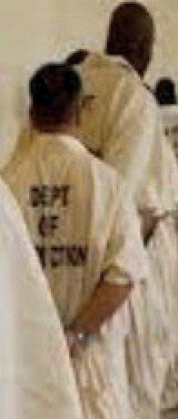
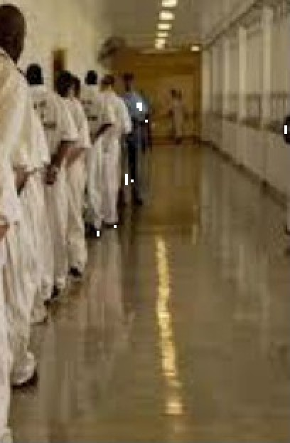
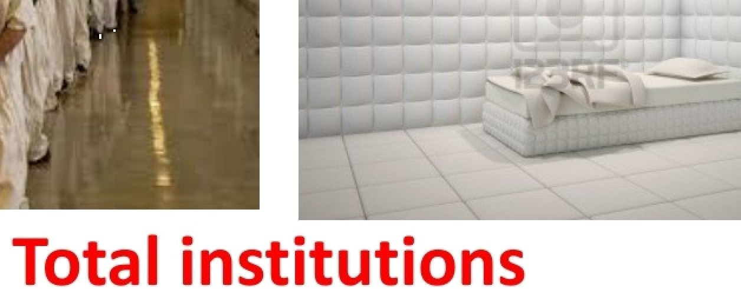
A setting in which people are isolated from the rest of society and are manipulated by an administrative staff (prison/mental hospital)
characteristics: staff members supervise all spheres of daily life, highly standardized, formal rules/schedules dictate daily routines

Slide 26
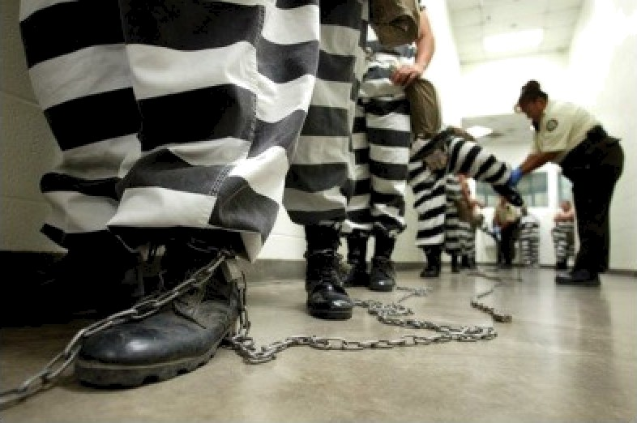
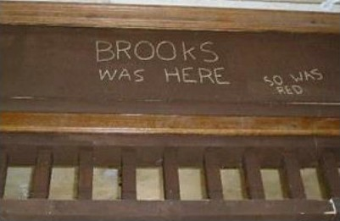
Re-socialization
Radically changing an inmate's personality by carefully controlling the environment
2 part process: break down inmate's identity via loss of privacy & humiliation, build a new self via rewards/punishments
Can rehabilitate or can become
institutionalized (unable to live any other way)

Slide 27
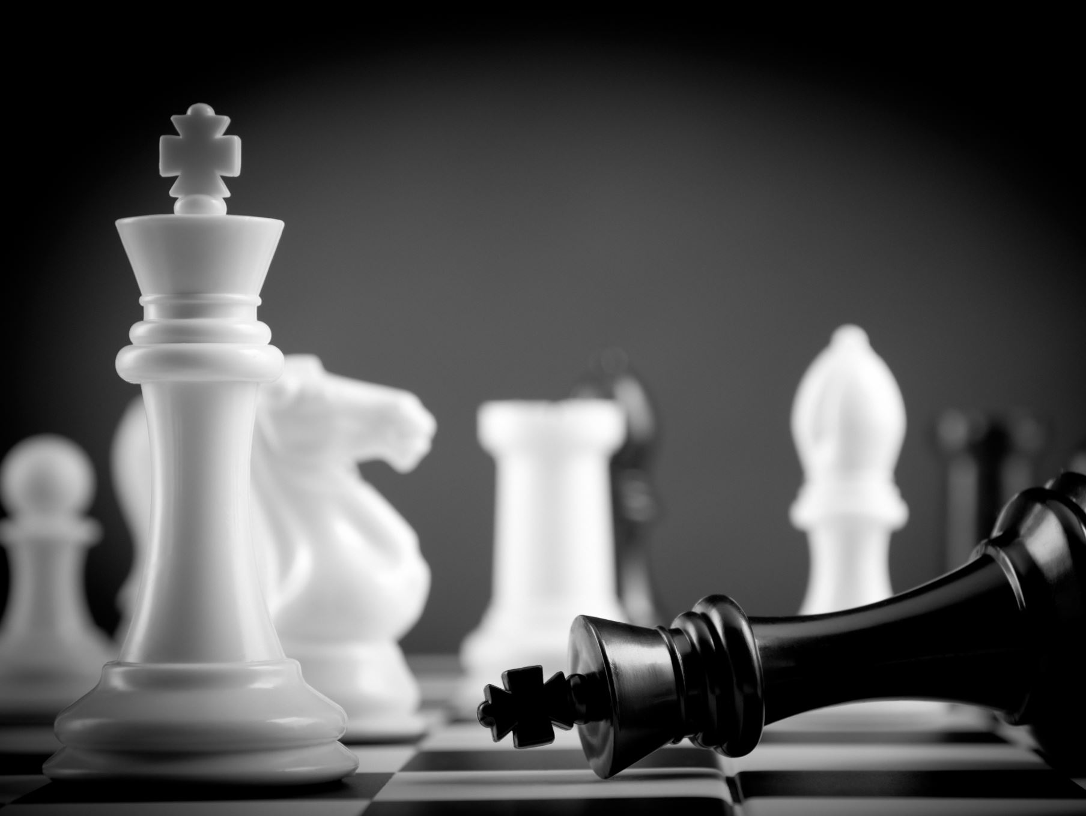
The End ☺

